Slide 1

Formatting

Slide 2
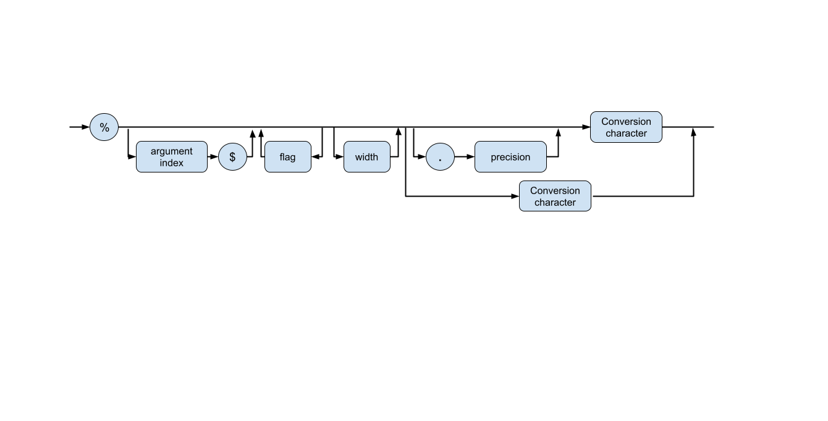
Format output
Formatted printing for the Java language is heavily inspired by C's printf. Although the format strings are similar to C, some customizations have been made to accommodate the Java language and exploit some of its features.
You can print a number x to the console with the statement System.out.print(x). That command will print x with the maximum number of nonzero digits for that type.
format speciﬁers %
conversion character

Slide 3
Format output
%[argument_index$][flags][width][.precision]conversion
The optional argument_index is a decimal integer indicating the position of the argument in the argument list. The first argument is referenced by "1$", the second by "2$", etc.
The optional flags is a set of characters that modify the output format. The set of valid flags depends on the conversion.
The optional width is a positive decimal integer indicating the minimum number of characters to be written to the output.
The optional precision is a non-negative decimal integer usually used to restrict the number of characters. The specific behavior depends on the conversion.
The required conversion is a character indicating how the argument should be formatted. The set of valid conversions for a given argument depends on the argument's data type.

Slide 4

Formatting output
Format specifiers
Flags for printf
Time Formatting characters
Date Formatting characters
Date/Time Formatting characters
Oracle documentation

Slide 5
String Formatting
public static String format(Locale l, String format, Object... args)
Since java 1.4
l - The locale to apply during formatting. If l is null then no localization is applied.
format - A format string.
args - Arguments referenced by the format specifiers in the format string.
public String formatted(Object... args)
Since java 15
Oracle documentation

Slide 6
MessageFormat
MessageFormat provides a means to produce concatenated messages in a language-neutral way. Use this to construct messages displayed for end users. MessageFormat takes a set of objects, formats them, then inserts the formatted strings into the pattern at the appropriate places.
Oracle documentation
Useful Article

Slide 7
NumberFormat
NumberFormat is the abstract base class for all number formats. This class provides the interface for formatting and parsing numbers. NumberFormat also provides methods for determining which locales have number formats, and what their names are. (Since java 1.1)
formatting numbers
grouping digits
fractiondigits
rounding numbers
formatting percentages
formatting currencies
parsing numbers
Oracle documentation

Slide 8
Interview Questions

Slide 9
Success is to be measured not so much by the position that one has reached in life as by the obstacles which he has overcome while trying to succeed.

